Slide 1
Brain Computer
Interface Application
C. Erastus Toe

Slide 2
Introduction
The basic idea of my project was to create a Brain Computer Interface Application to enable quadriplegic and the elderlies to interact with their environment by thoughts.
The BCI will enable them to control household devices like lights, TV, coffee maker etc.
I took on this project in the hopes that it will improve their lives and make everyday living a little easier.

Slide 3
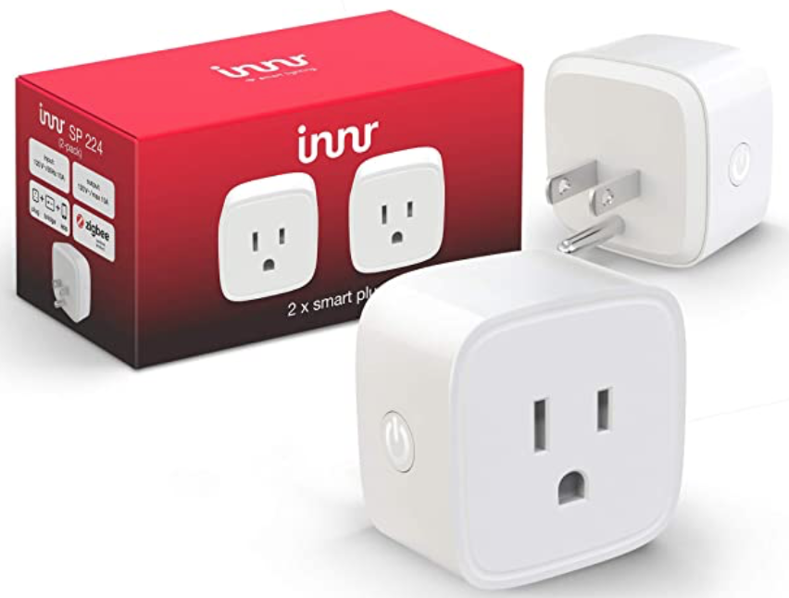
Hardware Needed (Used)
Smart Plugs x4 - $74.36

Slide 4
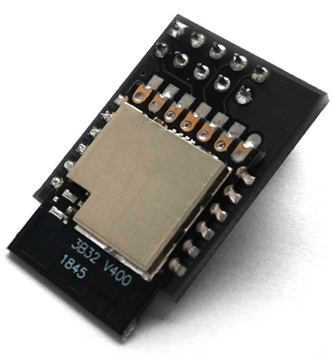
Hardware Needed
Elelabs Zigbee Raspberry Pi Shield = $20

Slide 5
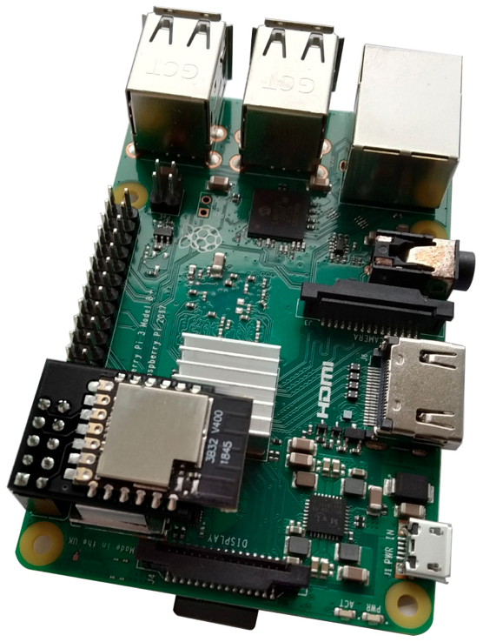
Hardware Needed
Raspberry Pi 3 = $49.99

Slide 6
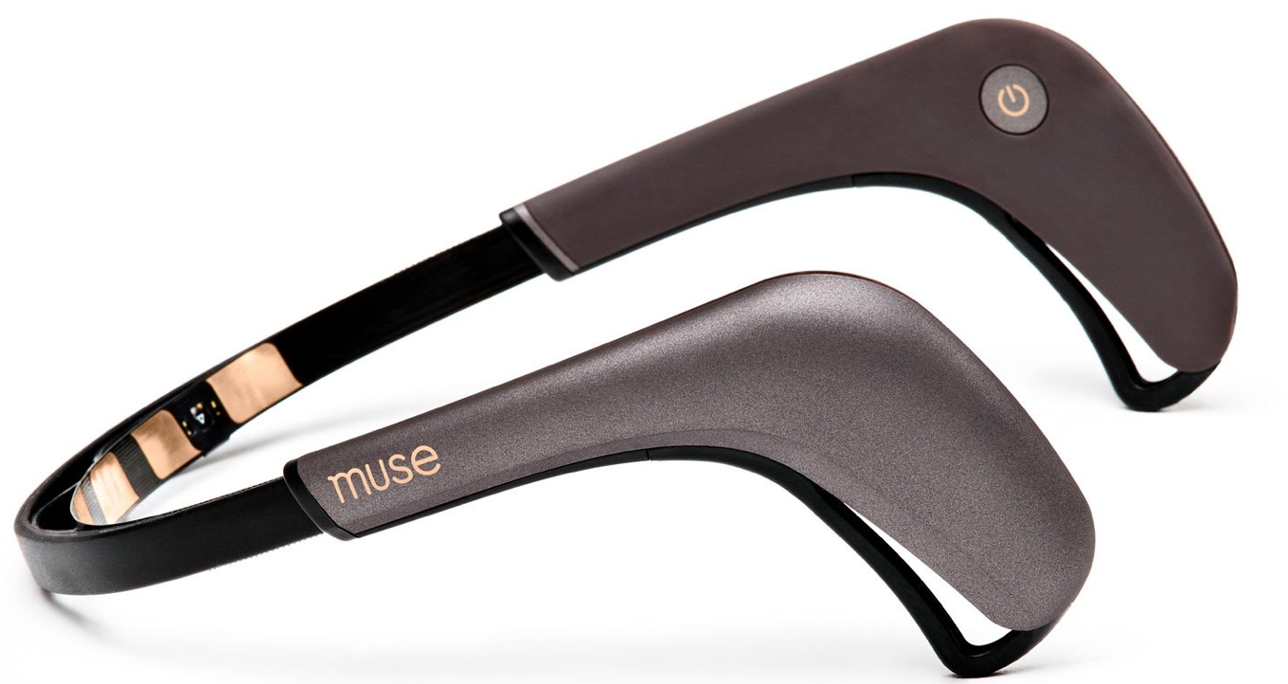
Hardware Needed
Muse sensor

Slide 7
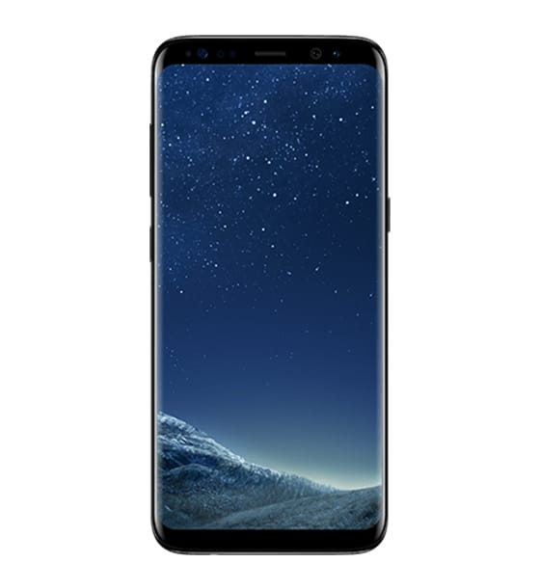
Hardware Needed
Android Phone

Slide 8
External Softwares & Tools
Zigpy
https://github.com/zigpy/zigpy
Firebase Database

Slide 9
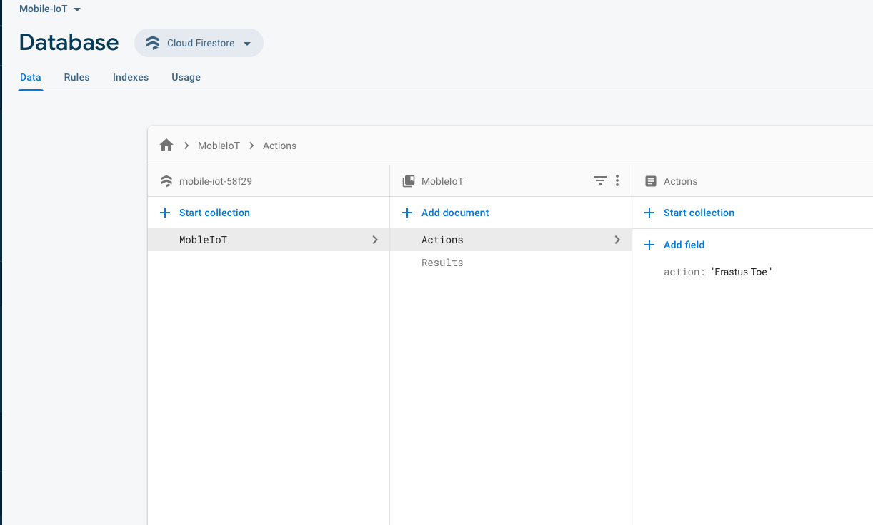
DataBase

Slide 10
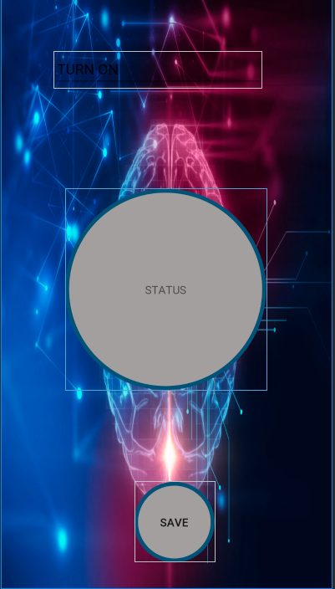

Slide 11
Results
A real time database
Connect the app and pi to the database
An app that read and write to the database in real time
A python program that read and write to the database in real time

Slide 12
The Future
I will finish the project
Prof Alif bought a Muse sensor for me
Waiting for the Shield

